Slide 1
Android Fundamentals
Final Project

Slide 2

Final Presentation Final Project
Project Description
Mock-ups
Rubric
Main issues/problems encountered
Future work
Demo

Slide 3
Project Description
I have decided to build a bus transit app. The main purpose of the app is to display to the user the next time a certain bus will depart from a station at its end of line. The app should read the user’s device time and show the next 2-3 times a certain bus will depart from one of its end stations. This information will be taken from Excel files located on the public transport for Cluj-Napoca site and dealt with accordingly. The app should also be able to purchase tickets by sending a customized message according to the user’s preference (one line 30 minutes, whole day pass etc.).

Slide 4
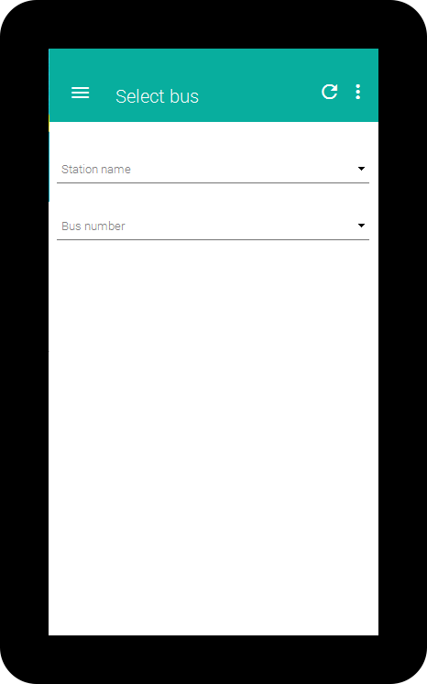
Mock-ups

Slide 5
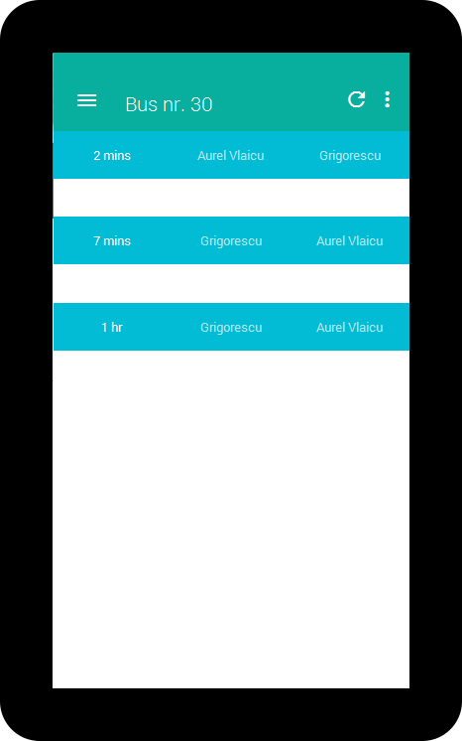

Slide 6
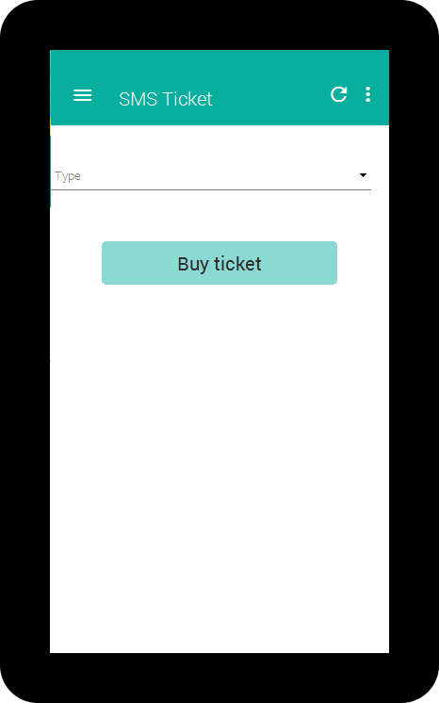

Slide 7
Rubric
Tablet Layout
Intents
Back btn Navigation
ContentProvider
SyncAdapter
IntentService
Loader
App State on screen rotation
Notes:
Table Layout – check if your app implements a layout for tablets (at least one screen)
Intents – check if you used intents to navigate between Activities
Back btn navigation – check if the back btn takes you back to the previous screen (and Up btn to the parent screen)
ContentProvider – check if you use it to access locally stored data
SyncAdapter – check if you regularly pull or send data to a web service or API and update at regular intervals
IntentService – check if you pull or send data to a web service or API only once or on request
Loader – check if you use it to load data into views
App State on screen rotation – check if app state is correctly preserved and restored on screen rotation:
When a list item is selected, it remains selected on rotation
When an activity is displayed, the same activity appears on rotation.
User text input is preserved on rotation.

Slide 8
Rubric – Extra points
Notifications
ShareActionProvider
Broadcast Events
Custom Views
Notes:
Notification – check if you used notifications
ShareActionProvider – check if the Share functionality is implemented
Broadcast Events – check if your app intercepts and reacts to Broadcast events
Custom Views – check if you implemented your own view

Slide 9
Main issues/problems
Unable to correctly parse the Excel files (couldn’t get the departure times)

Slide 10
Future work
-Displaying the departure times for each end of a bus
-Storing these times in a database
-Calculating approximate arrival times for intermediate stations on a bus’ route
-Periodically update data fetched from Cluj-Napoca’s public transport site (using SyncAdapter)

Slide 11
Will you put it up on Google Play?
YES

Slide 12
Demo

